Slide 1

Team 1
Alejandra Vila, Amit Som, Ishaan Dhillon, Abraham Osman, Megan Osorio, Ruizhe Xiong

Slide 2
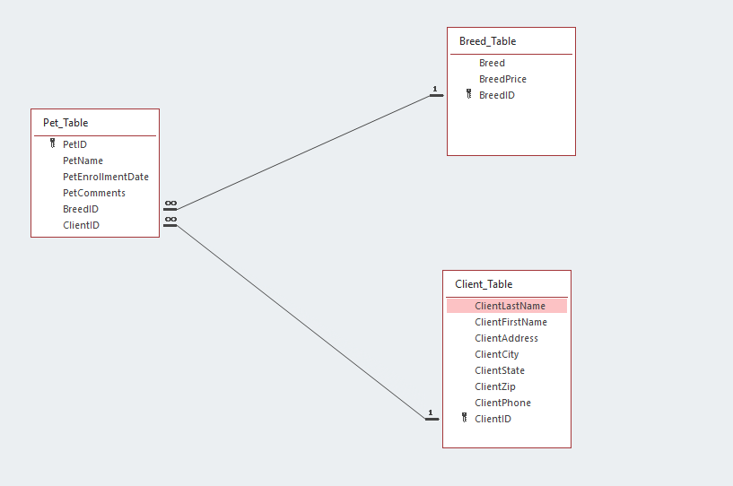
Part A
Develop a 3-table model
Notes:
ClientID, BreedID are foreign keys in the Pet Table

Slide 3
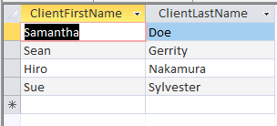
Part A
Query A: Which clients are located in Round Rock? Provide their first and last names
SELECT ClientFirstName, ClientLastName
FROM Client_Table
WHERE ClientCity = ‘Round Rock’

Slide 4
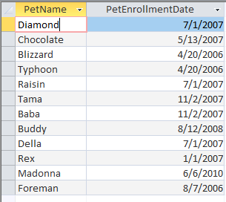
Part A
Query B: Which pets are beagles? List the pet’s name and enrollment date?
SELECT P.PetName, P.PetEnrollmentDate
FROM Pet_Table P, Breed_Table B
WHERE P.BreedID = B.BreedID AND B.Breed = 'Beagle';

Slide 5

Part A
Query C: How many total clients does Ms. Hannah have?
SELECT count(ClientID) AS ClientCount
FROM Client_Table;

Slide 6
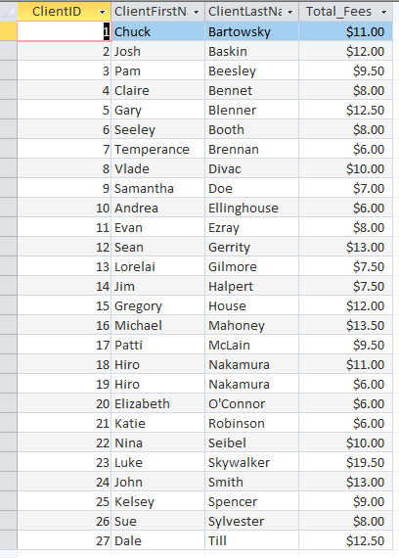
Part A
Query D: What are the total pet walking fees charged to each client? Show the client’s first and last names and the total fees charged
SELECT C.ClientID, ClientFirstName, ClientLastName, sum(BreedPrice) AS Total_Fees
FROM Pet_Table P, Client_Table C, Breed_Table B
WHERE P.BreedID = B.BreedID AND P.ClientID = C.ClientID
GROUP BY C.ClientID, ClientFirstName, ClientLastName;

Slide 7
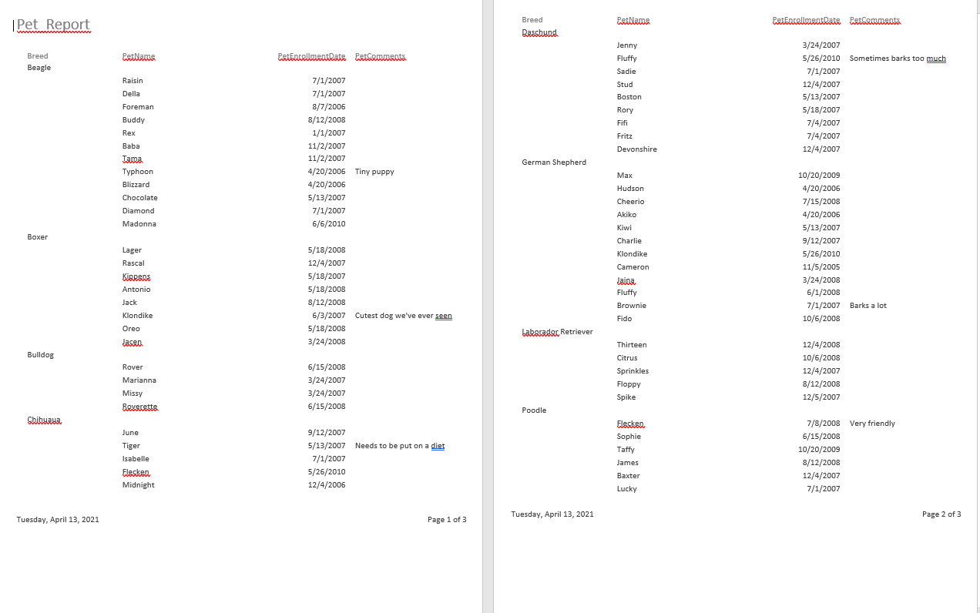

Part A
REPORT

Slide 8
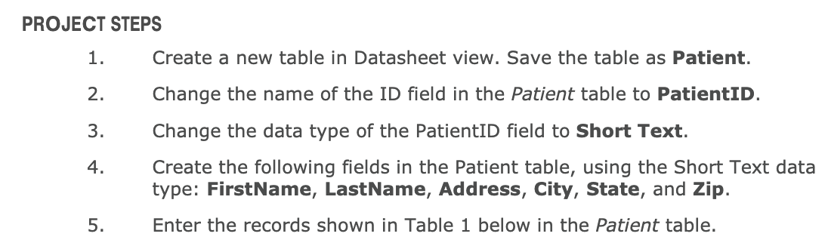

PART b
BEFORE AFTER

Slide 9
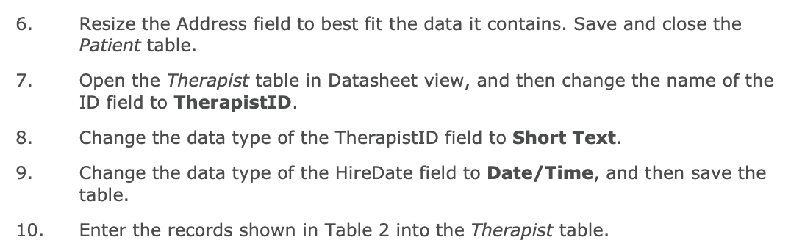

PART b
BEFORE AFTER

Slide 10
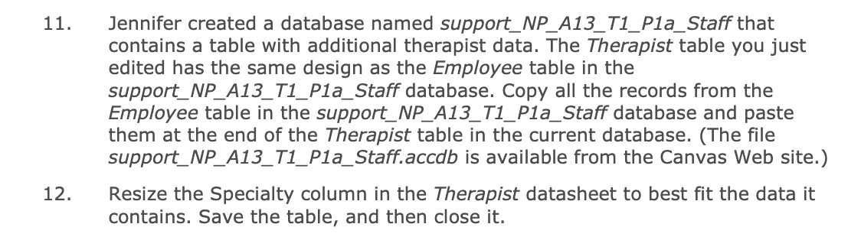
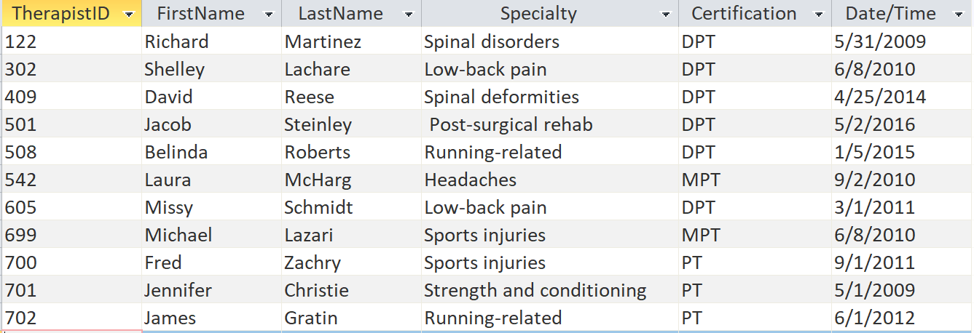
Part B
BEFORE AFTER

Slide 11
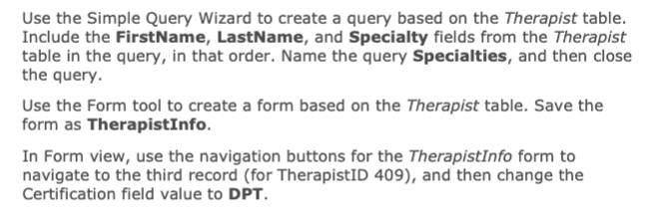
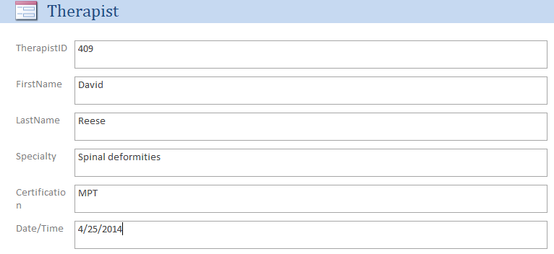
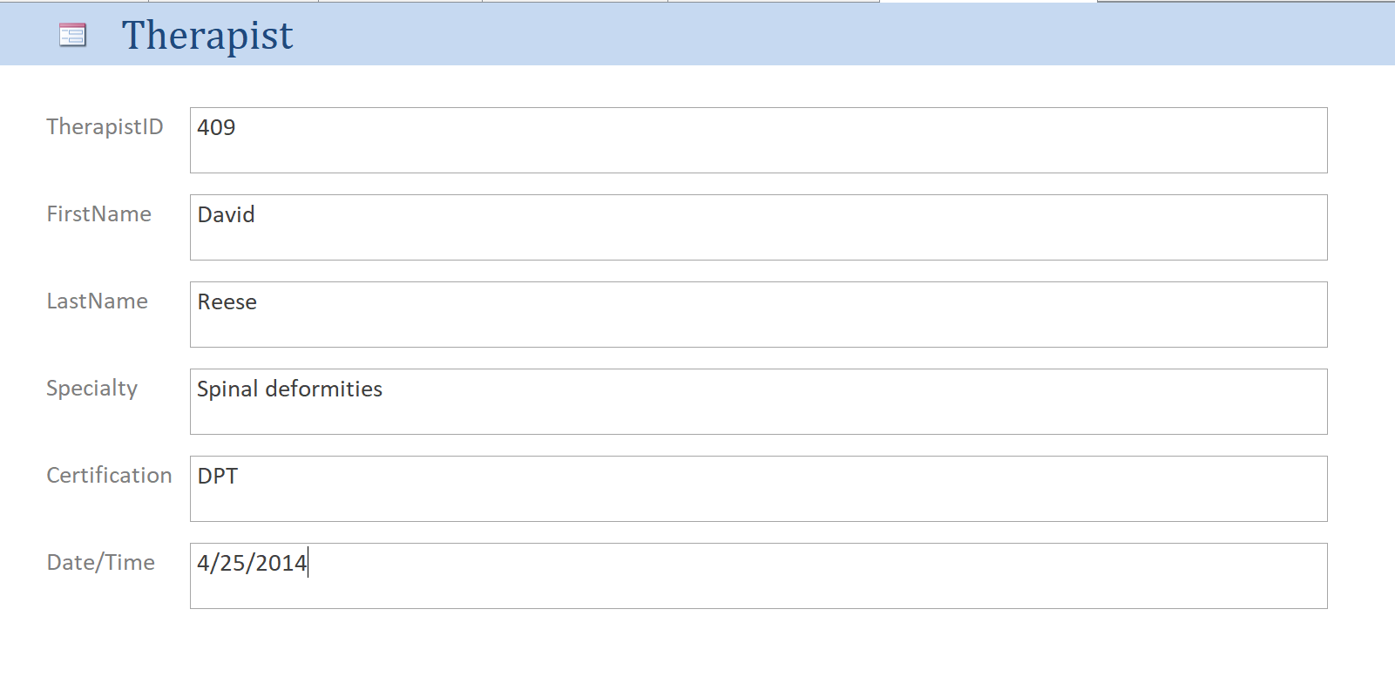
Part B
BEFORE AFTER

Slide 12
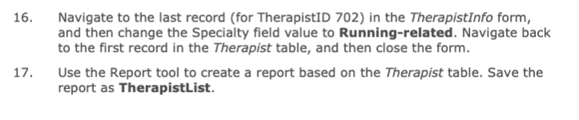
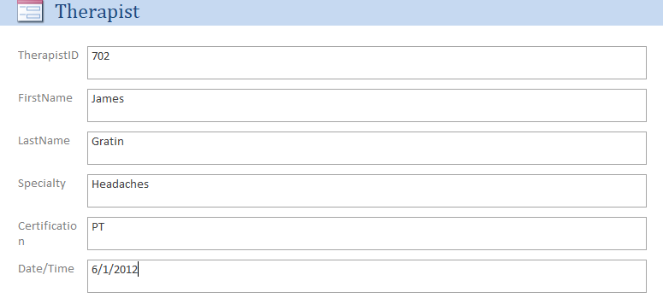
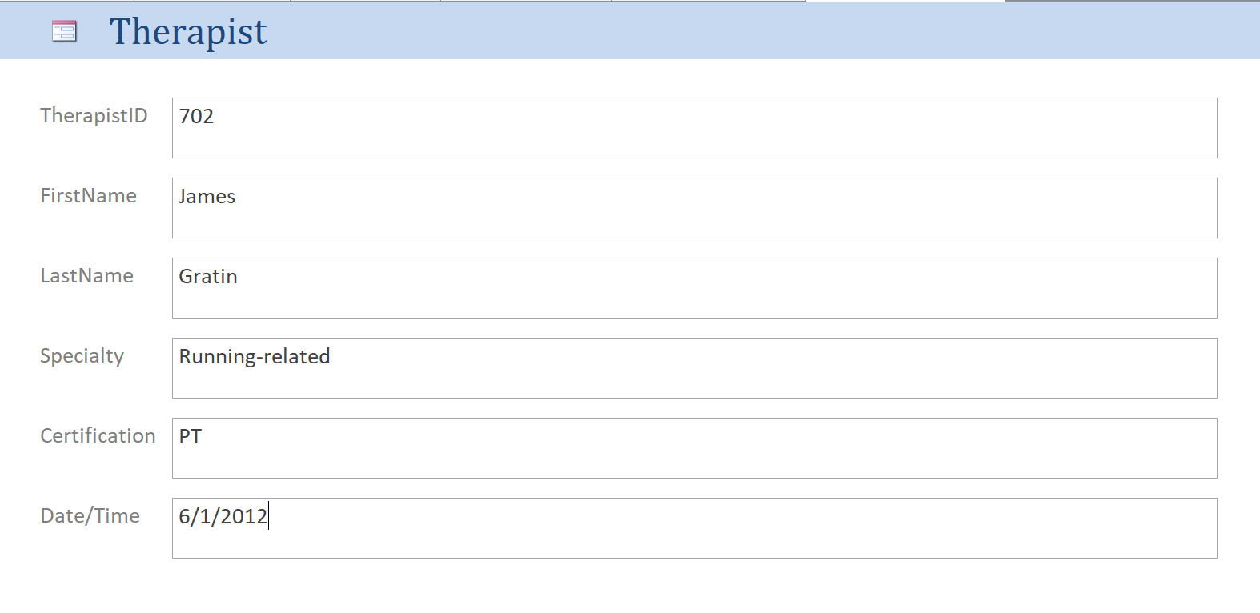
Part B
BEFORE AFTER

Slide 13
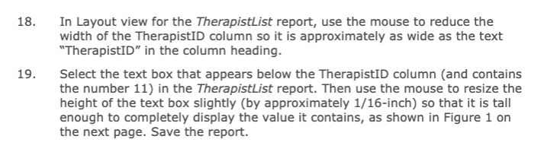
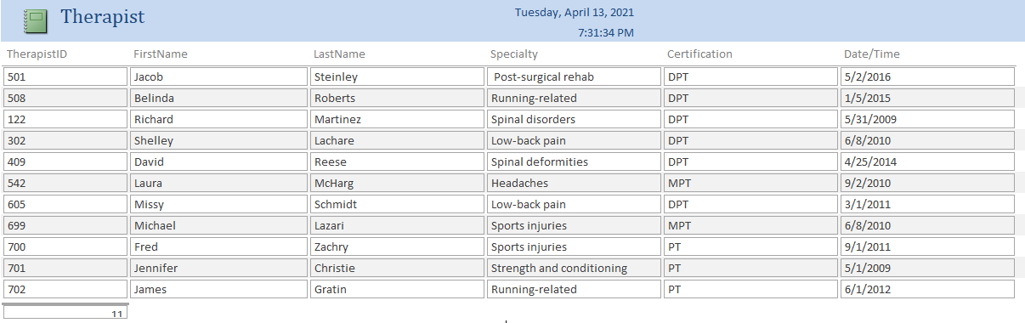
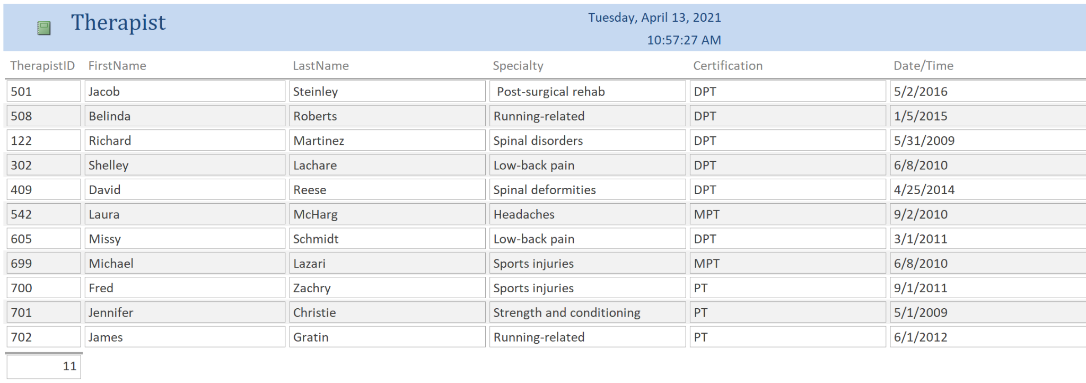
Part B
BEFORE AFTER

Slide 14
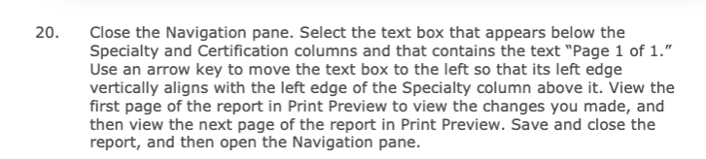
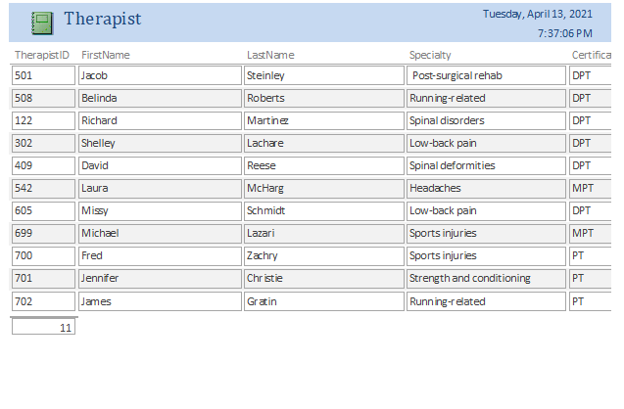
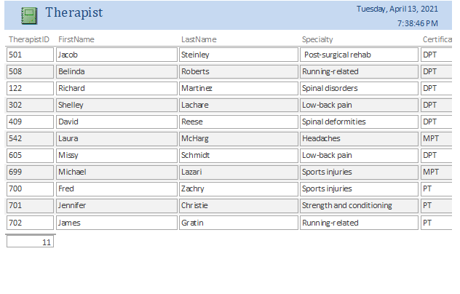
Part B
BEFORE AFTER

